Slide 1
Identification of Three-lobed Water-crowfoot

Slide 2
WARNING
Identifying water-crowfoot species is not easy!!
Even the national expert referee for the group says it’s often better to record Ranunculus sp. Rather than to attempt an identification
Everyone is waiting on the results of genetic work to try and sort the group out
this may result in many more species e.g. Thread-leaved Water-crowfoot (Ranunculus trichophyllus) may include a dozen or more distinct genetic types
some populations once thought to be pure’ may just be hybrids e.g. Three-lobed Water-crowfoot (Ranunculus tripartitus)
Notes:
More on identification later

Slide 3
Good news ☺
We don’t have to wait years for people to sort out the taxonomy – especially on sites where we know we have one of the Ranunculus that’s of interest to conservation.
e.g. part of the Ranunculus tripartitus group
Three-lobed Water-crowfoot is also one of the more distinctive water-crowfoot species
We don’t have to worry about the other Ranunculus for this survey – only that we can identify this one species
The critical method for identification is to use a checklist of features to reach your identification
i.e. can I find feature A + B + C = yes; then it’s highly likely to be Three-lobed Water-crowfoot
Notes:
Least concern in Wales

Slide 4
Step 1:
In temporary pond habitats; look at the flower size:
Are the majority of flowers large (all with petals bigger than 6mm)
A water-crowfoot but not Three-lobed Water-crowfoot
Are the majority of flowers small (all with petals less than 6mm)
A mud edge water-crowfoot (go to Step 2)

Slide 5
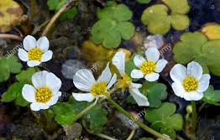
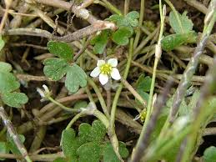
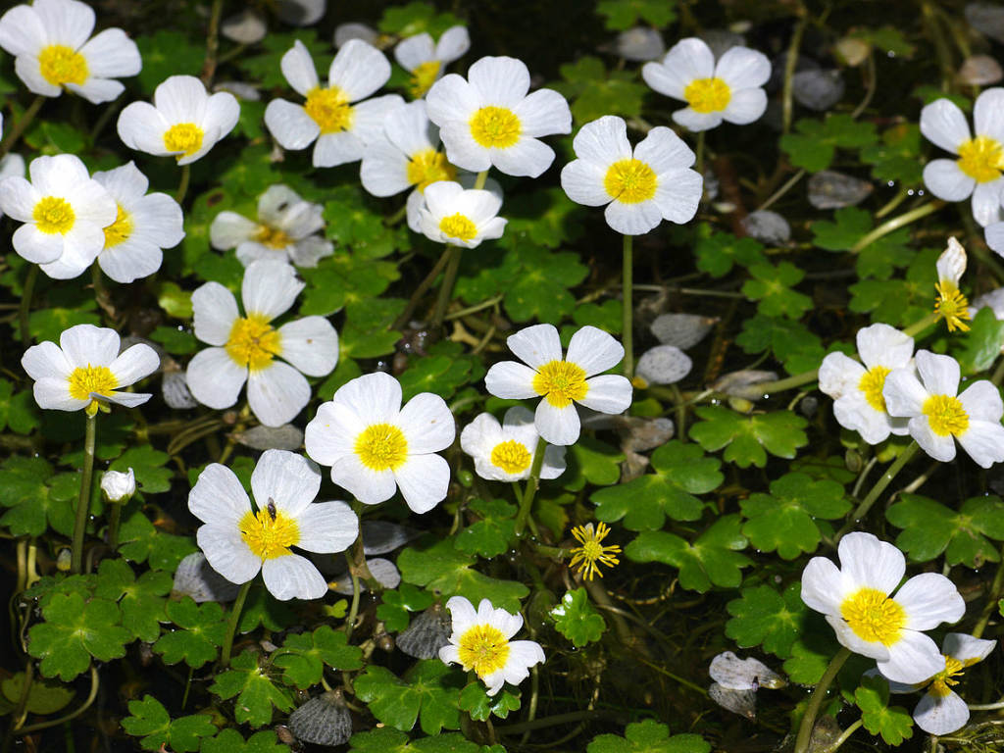
Flower petals - 6mm
Flower petals 6mm+
A quick visual check can be done by comparing the flower size relative to the floating leaves

Slide 6
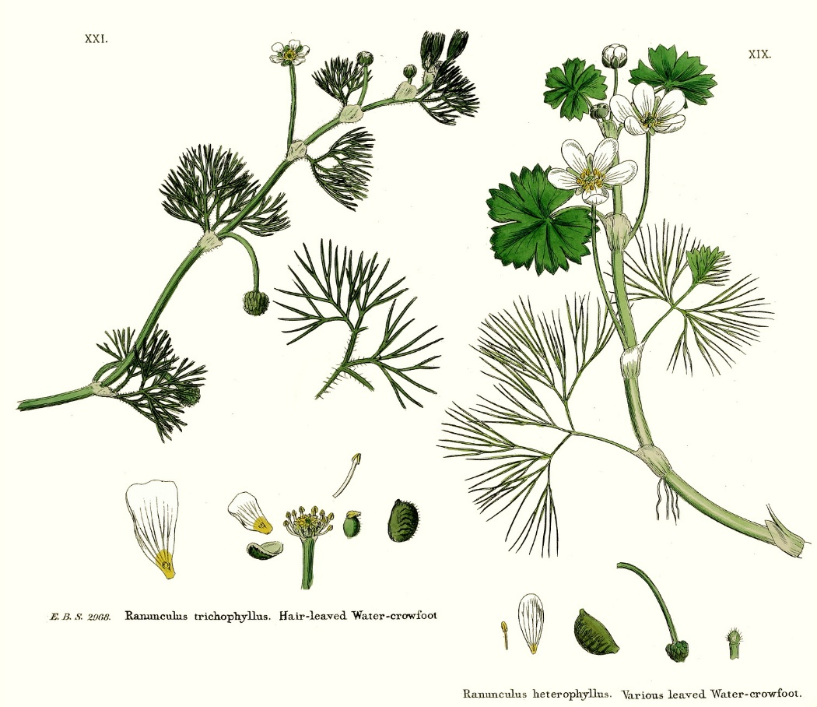
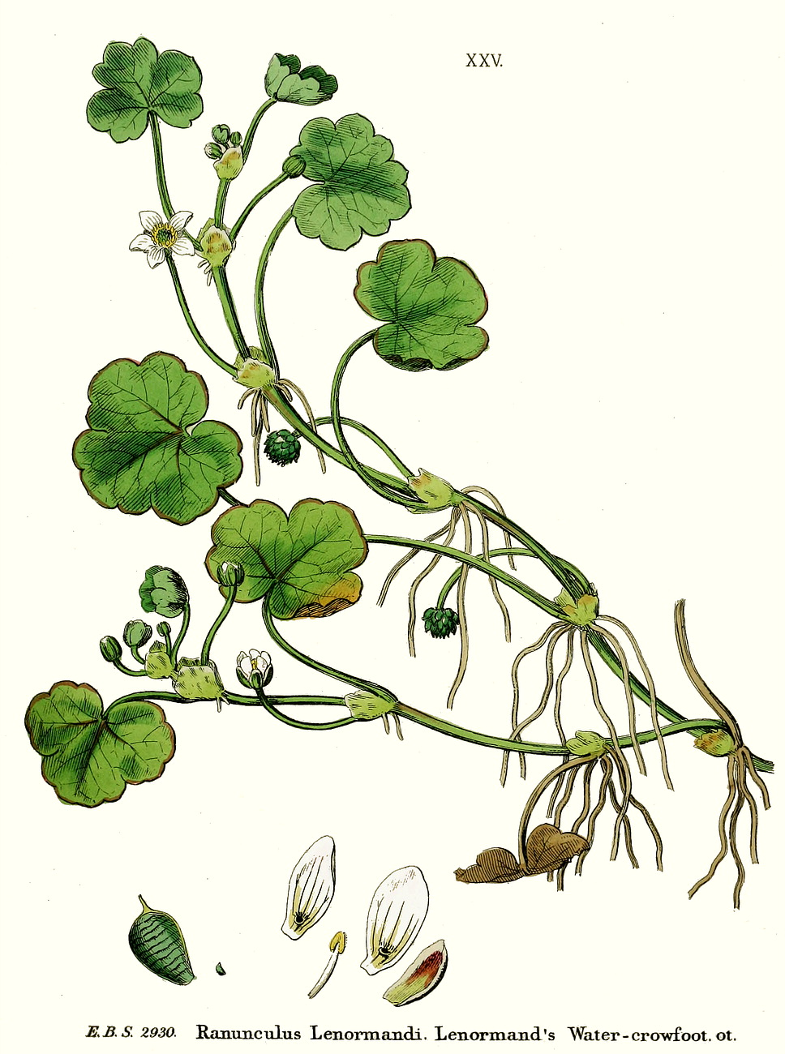
Step 2A:
Look at the leaves
Ranunculus sp. can have two types of leaves – broad floating (laminar) leaves, thread-like (capillary leaves)
Notes:
Mention here also the intermediate leaves – the examples given show a Ranunculus with only capillary leaves, one with both and one with only laminar leaves

Slide 7
Step 2A:
Look at the leaves
There are no capillary leaves
Unlikely to be Three-lobed Water-crowfoot, make a note and go on to step 2B
There are both laminar and capillary leaves
Could to be Three-lobed Water-crowfoot, make a note and go on to step 2B

Slide 8
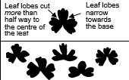
Step 2B:
Look at the leaves
Leaves usually deeply 3-lobed (rarely 5-lobed), lobes narrowest at base, central lobe narrower than lateral lobes
Could be Three-lobed Water-crowfoot, make a note and go on to step 2C
Notes:
Mention here also the variability in leaves – we are looking for the majority

Slide 9
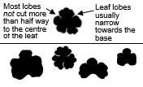
Step 2B:
Look at the leaves
Leaves usually shallowly 5-lobed (rarely 3- or 7-lobed), lobes narrowest at base
Unlikely to be Three-lobed Water-crowfoot, could be Round-leaved Water-crowfoot, make a note and go on to step 2C
Notes:
Mention here also the variability in leaves – we are looking for the majority

Slide 10
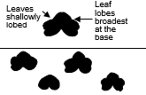
Step 2B:
Look at the leaves
Leaves usually shallowly 5-lobed (rarely 3- or 7-lobed), lobes narrowest at base
Unlikely to be Three-lobed Water-crowfoot, could be Ivy-leaved Water-crowfoot, make a note and go on to step 2C
Notes:
Mention here also the variability in leaves – we are looking for the majority

Slide 11
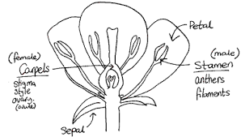
Step 2C:
Look at the sepals
The sepal is the green part of the flower head which protects the flower in bud

Slide 12
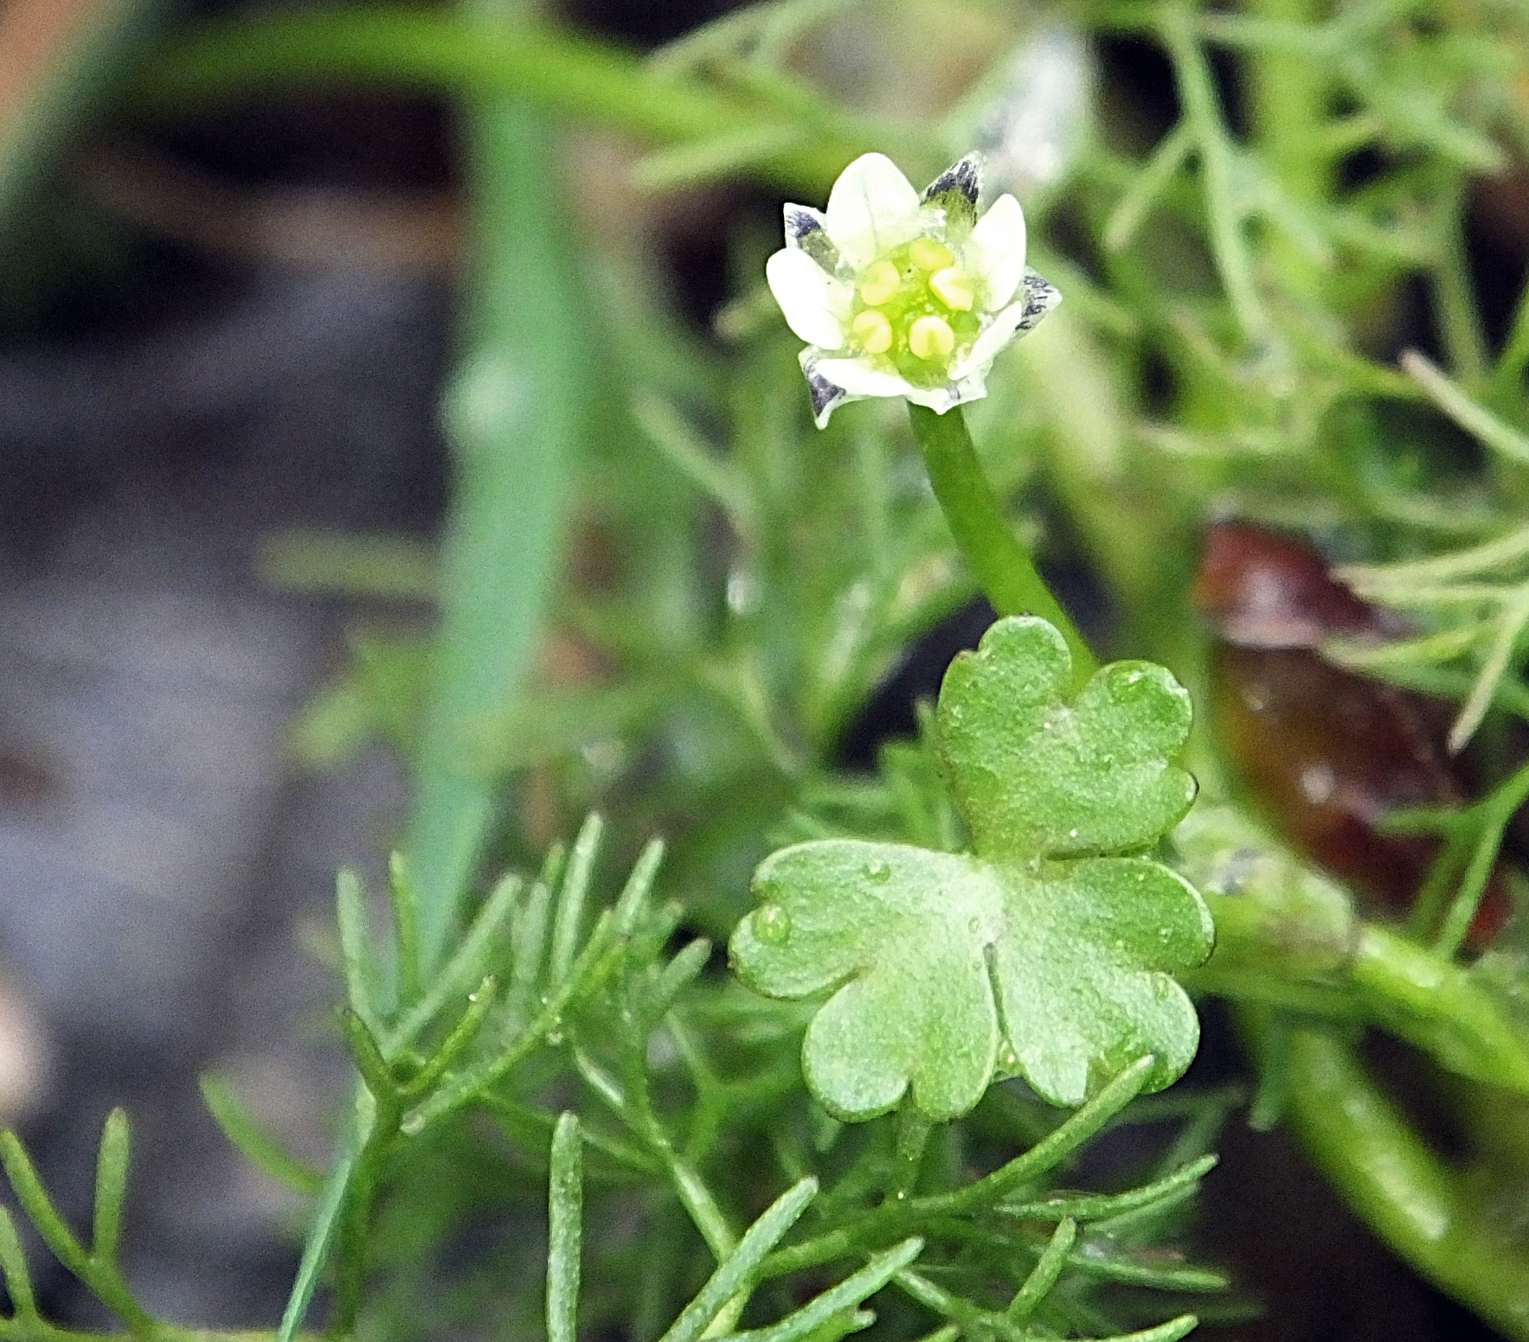
Step 2C:
Look at the
sepals
Sepals the same size or only slightly smaller than the petals
Could be Three-lobed Water-crowfoot, make a note and go on to step 3

Slide 13
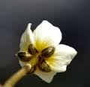
Step 2C:
Look at the
sepals
Sepals smaller than the petals
Unlikely to be Three-lobed Water-crowfoot, make a note and go on to step 3

Slide 14
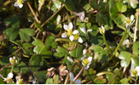
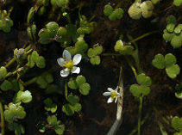
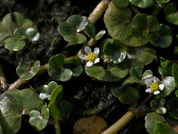
Step 3:
Take an overview
3- lobed laminar leaves. Capillary leaves present. Middle often resembles a crown with three peaks. Smaller flowers. Petals similar or slightly longer than the sepals underneath. Flowers Dec – May.
5- lobed laminar. Capillary leaves absent. Leaf outline often rather rounded. Leaf lobes sometimes overlap. Has larger flowers. Petals 2 to 3 times longer than the sepals beneath. Flowers March – November.
5- lobed laminar. Capillary leaves absent. Leaf outline often rather triangular. Mature leaves can have dark green marks near the centre. Petals and sepals similar length. Flowers March – November.

Slide 15
The hybrid
Three-lobed Water-crowfoot (Ranunculus tripartitus) can hybridise with Round-leaved Water-crowfoot (Ranunculus omiophyllus) to create the rare hybrid R. novae-forestae.
The hybrid often has a leaf shape and flower size that are intermediate between its parents, but both are very variable, and ideally genetic analysis would be required to make an accurate distinction between them.
Notes:
Mention here about the curved fruit stalk

